Slide 1
C to C++ Transition

Slide 2
Input/Output
Input/Output
C - printf/scanf
C++ - cout/cin
prog1_1.cpp

Slide 3
Data Types
Most data types are the same as C
We will look quickly at:
Integer Data Types
Floating-Point Data Type
Char Data Type
String Class
Bool Data Type

Slide 4
Integer Data Type
Data Type | Typical Size | Typical Range
short int | 2 bytes | -32,768 to +32,767
unsigned short int | 2 bytes | 0 to +65,535
int | 4 bytes | -2,147,483,648 to +2,147, 483, 647
unsigned int | 4 bytes | 0 to 4,294,967,295
long int | 4 bytes | -2,147,483,648 to +2,147,483,647
unsigned long int | 4 bytes | 0 to 4,294,967,295
long long int | 8 bytes | -9,223,372,036,854,775,808 to +9,223,372,036,854,775,807
unsigned long long | 8 bytes | 0 to +8,446,744,073,709,551,615

Slide 5
Long Long
Long Long has been available since C++11
prog2_9.cpp
To ensure the variable is stored as an 8 byte long long you should put LL after the number when initializing. Some compilers may optimize your variable to a smaller size.
long long int var = 89LL; you could use lower case ll but this looks to much like one’s so it is best to use capital LL

Slide 6
Floating Point Data Types
Data Type | Key Word | Size | Range | Significant Digits
Single Precision | float | 4 bytes | 3.4E-38 to 3.4E38 | 7
Double Precision | double | 8 bytes | 1.7E-308 to 1.7E308 | 16
Long Double Precision | long double | 8 bytes | 1.7E-308 to 1.7E308 | 16
prog2_11.cpp

Slide 7
Char and String
C++ char is the same as a C char, so we will not spend time on this.
String however, is a new data type
We represent strings in C as a char array
In C++ we have a string class which allows us to create a variable of type string. No longer need a char array.
When using strings you need to include the string class:
#include <string>
string name;
name = “Yvon Feaster”

Slide 8
Boolean Data Type
Boolean variables are set to either true or false
Use the keyword bool to create a boolean type
Ex.
bool value = true;

Slide 9
Auto
C++11 introduces an alternative way to define variables by using the auto key word and an initialization value. The data type is determined by the initialization value. Below are examples:
auto amount = 100; (an int)
auto letter = ‘A’; (a char)
auto customerNum = 456L; (long int)
auto num = amount; (since amount is an int so is num)

Slide 10
Auto
Note that string literal has the type const char*, using auto for string literals may lead to an upleasant surprise
auto s1 = “San Antonio”; // s1 is a const char*
string s2 = “Fredericksburg”; // s2 is a string
Auto is very useful with rang based for loop which we will talk about next

Slide 11
Range-Based For Loop
A range-based for loop iterates once for each element in an array. Each time the loop iterate, it copies an element from the array to a variable. Range-based for loops were introduce in C++11.
Syntax:
for(dataType rangeVariable : array)
{
Statement;
}
autoTest.cpp

Slide 12
Namespace
Namespace provides a method for preventing name conflicts in large projects. Symbols declared inside a namespace block are placed in a named scope that prevents them from be mistaken for identically-named symbols in other scope
Consider the case where we have two students in the same class with the same first name. When I need to differentiate them I would need to use something in addition to their name to identify them. It may be their last name.
namespace.cpp, namespace2.cpp, and namespace3.cpp

Slide 13
Formatting Output
cout provides ways to format data as it is being displayed.
This affects the way data appears on the screen

Slide 14
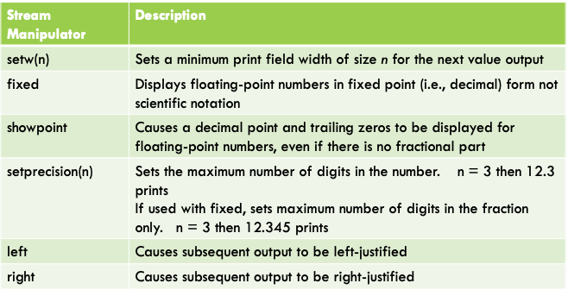
Formatting Output

Slide 15
Formatting Output
prog3_15.cpp (must use #include <iomanip>)
The first three lines of output will be unstructured
However sometimes we want the output to be more structured

Slide 16
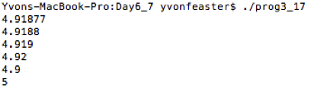
Formatting Output
setprecision() - allows us to set the number of significant digits that will be printed. This is the total digits printed (includes numbers before and after the decimal point)
Rounds the number rather than truncates
Trailing zeros are omitted
prog3_17.cpp

Slide 17
Formatting Output
fixed — is another stream manipulator which will prevent a large number from printing in scientific notation.
Ex. Given a number 145678.99 the following will normally print 1.4568e+005. Using fixed forces the number to print in fixed-point notation (decimal)
Using fixed with setprecision() - specifies the number of digits to be displayed after the decimal point of a floating-point number, rather than the total number of digits to be displayed
Modify prog3_17.cpp to include fixed

Slide 18
Formatting Output
showpoint - by default, if x = 456.0 and we print x then what will print is 456 (no decimal no trailing 0’s) if we want the number to print 456.0 then specify showpoint
showpoint, fixed and setprecision can be used together
Ex. double x = 456.0; cout << fixed << showpoint << setprecision(2) << x << endl; would result in 456.00
fixed, showpoint, and setprecision have no effect on integer values only floating point numbers

Slide 19
Formatting Output Continued
left and right manipulators - used to force left or right justification
once set it stays set until changed
used with all type of variables

Slide 20
Working With Char and Strings
C - provides char (character)
A c-style string is an array of characters
C++ allows us to use char and string
Inputting strings
Cin ignores leading whitespace characters - however, once it comes to the first non blank character, starts reading — stops reading when get to the next whitespace — what if you have a first and last name or even a sentence?
Use getline(cin, variableName) to get input that has spaces
prog3_19.cpp(broken) and prog3_20.cpp (fixed)

Slide 21
Working with Characters and Strings
We have already seen cin (c++ version of scanf)
Using cin.get() and cin.ignore() and mixing the two prog3_22.cpp
C++ string object provides relational operators that allow us to compare strings as well as easily concatenate strings.
prog3_23.cpp

Slide 22
String Operators
In C we compare strings by using the strcmp() function
In C++ strings use relational operators to directly compare strings — uses ascii values
Ex. string name1 = “Mary”; string name2 = “Mark”;
These can be be compared:
name1 > name2; // ture
name1 <= name2; //false
name1 != name2; //true
name1 < “Mary Sue”; // true

Slide 23
Reference Variable
A reference variable is a variable that references the memory location of another variable
Any change to the reference variable will change the variable it is referencing
Can be used as function parameters
C++ syntax
int var = 5;
int& refvar = var; //reference to an int

Slide 24
Reference vs Pointer
There are 3 major differences between references and pointers
References can not be NULL – must be connected to a legitimate piece of storage.
Once initialized to an object, it cannot be changed to reference another object. Pointers can be pointed to another object at any time.
A reference must be initialized when it is created. Pointers can be initialized at any time.
Refer_ex.cpp

Slide 25
Type Casting
C - style type casting
Ex: double num = 3.7;
int val;
val = (int) num;
C++ - style type casting
val = static_cast <int>(num);
Pre-standard C++ style type casting
val = int (num);
The static_cast form is the ANSI
(American National Standard Institute)
standard now. However, you may see
C-style or pre-standard style being used
in old code.
For this class we will use the C++ style
type casting.

Slide 26
Constant Variables vs #define
Const double PI = 3.14159;
Cannot be changed(read-only)
Is an actual variable with a memory location
Must give it a value when declaring
#define PI 3.14159
Cannot be changed(read-only)
Is NOT a variable but a preprocessing directive - it is a text substitute
Must give it a value when creating

Slide 27
C File Pointers
In C we use:
FILE* fp = fopen(“filename”, “r” or “w”)
When we are done with the file we must close it using fclose(fp)

Slide 28
C++ File Input
Must #include <fstream>
Two ways to declare and open a file in C++
Declare first then open it
ifstream input;
input.open(“nameOfFile.txt”);
Declare and open the file simultaneous
ifstream input(“nameOfFile.txt”);
Notice “i” in ifstream means input

Slide 29
Input Example
Write to a file
C - fprintf or write
C++ — Input
prog5_18.cpp, Friends.txt, wholename.txt

Slide 30
File Output
C++ output
#include <fstream>
Declare a file pointer and open the file
ofstream outputFile; “o for output”
outputFile.open(“fileName.txt”);
Close a file when you are done.
outputFile.close(); to close the file
Declare and open a file simultaneous
ofstream outputFile(“fileName.txt”);

Slide 31
Output Example
Read from a file
C — fscanf or bread
C++ — Output
prog5_16.cpp

Slide 32
More File I/O
Detecting the end of a file
C — check for EOF
C++ — use >> operator or eof
prog5_22.cpp
Revisit eof.cpp, eof.txt

